Slide 1



Slide 2
Problem statement
Internal combustion engines do not efficiently convert the energy in their fuel to mechanical energy.
Most of the energy that is not utilized is in the form of heat.
Increasing fuel efficiency standards create a market for harvesting waste heat.
GHSP manufactures pumps and other products for which there is a lot of technical knowledge overlap with vapor power generation cycles.

Slide 3
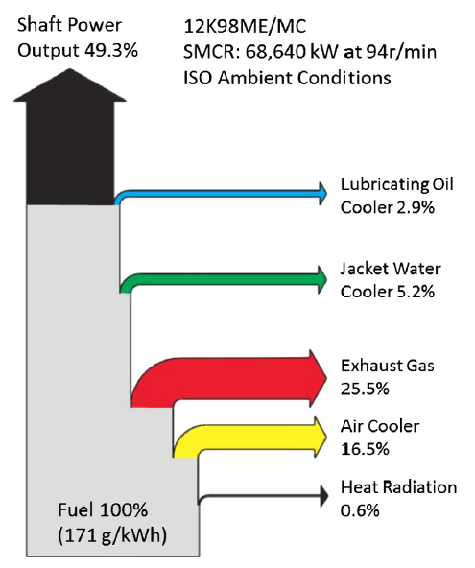
Waste heat
This diagram represents a MAN 12K98ME/MC marine diesel engine operating at 100 SMCR under ISO conditions.
This power breakdown is considerably more efficient than many automotive applications; though the ratios between cooling water and exhaust are similar.

Slide 4
Waste heat recovery strategies
Thermoelectric generation
Peizoelectric generation
Turbo-chargers
Vapor power

Slide 5
Thermoelectric and piezoelectric generation
Low output
Exotic materials
No moving parts
Conceptually simple

Slide 6
Turbocharger
Well established
Implemented in many platforms already
Good solution, something more is needed to meet increasing restrictions.

Slide 7
Vapor power
More conceptually complex
Low temperature, low quality heat is useable
Good match for existing GHSP competencies
Form factor of heat source is convenient for a cross-flow heat exchanger.

Slide 8
Plan of study
Organic Rankine cycle
Working fluid selection
Working pressures and temperature optimization
Heat exchanger size
Overall feasibility of building a commercial prototype

Slide 9

Theoretical background
$$ΔKE+ΔPE+ΔU=\left(Q_{in}−Q_{out}\right)−\left(W_{out}−W_{in}\right)$$
$$Q_{in}−Q_{out}=W_{out}−W_{in}$$
$\frac{{\dot{Q}}_{in}}{\dot{m}}=h_{1}−h_{4}$; $\frac{{\dot{Q}}_{out}}{\dot{m}}=h_{2}−h_{3}$
$$\dot{\frac{W_{p}}{\dot{m}}}=h_{4}−h_{3}=ν_{3}\left(p_{4}−p_{3}\right)$$
Notes:
Enthalpy The sum of the internal energy of a system and the product of its pressure and volume H = U +pV

Slide 10
Technical hurdles
Low temperature differentials lead to large heat exchanger area requirements.
Working fluids with sufficiently low phase transition temperatures are often flammable, fouling, ozone depleters and/or chemically complex to synthesize.
Energy availability – The heat available must be substantial enough, that a low efficiency process will be economically feasible

Slide 11
Technical feasibility
In order to evaluate the feasibility of a heat recovery system, a numerical model was made to find the power output, efficiency, heat transfer in, and heat transfer out of a system given working pressures of the boiler and condenser.

Slide 12
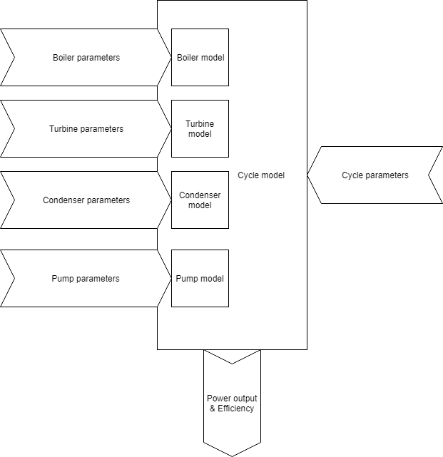
Model components

Slide 13
Model components
Working pressures for the boiler and for the condenser are fixed by the user.
The turbine efficiency and pump efficiency are entered by the user. Pump efficiency is usually quite high, while turbine efficiency is somewhat lower – in the code validation section the referenced study turbine efficiency was 0.787.
Other properties at the condensed vapor and condensed liquid states are determined from a lookup table by interpolating the two nearest points to the working pressures selected. Temperature, enthalpy, entropy

Slide 14

Model components
The enthalpy at state 2 is found using:
$$h_{2}=h_{f}+x_{2}h_{fg}$$
Where h_{f} is the enthalpy of a saturated liquid, h_{fg} is the evaporation enthalpy – the width of the vapor dome – and x₂ is the quality of the vapor-liquid mixture at state 2 which is given by the following:
$$x_{2}=\frac{s_{2}−s_{f}}{s_{g}−s_{f}}$$
Note that for R245fa, x₂ is very close to 1.

Slide 15
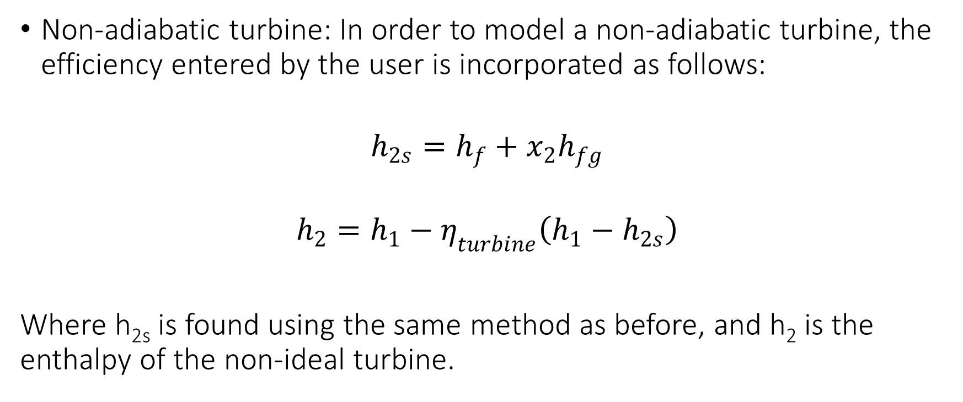
Model components
Non-adiabatic turbine: In order to model a non-adiabatic turbine, the efficiency entered by the user is incorporated as follows:
$$h_{2s}=h_{f}+x_{2}h_{fg}$$
$$h_{2}=h_{1}−η_{turbine}\left(h_{1}−h_{2s}\right)$$
Where h_{2s} is found using the same method as before, and h₂ is the enthalpy of the non-ideal turbine.

Slide 16
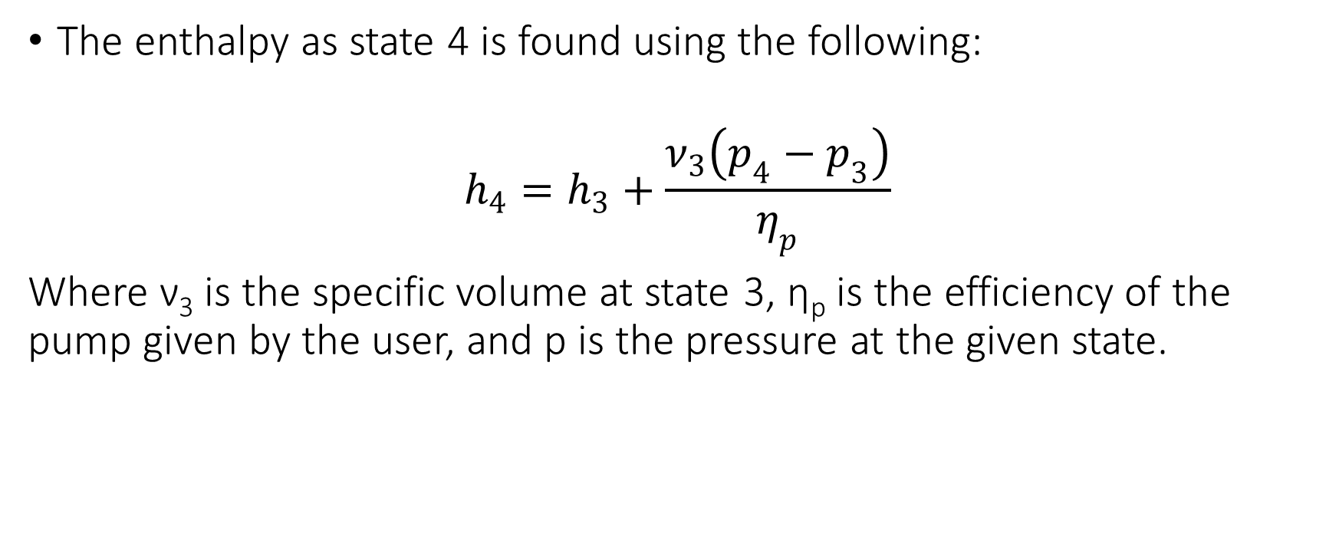
Model components
The enthalpy as state 4 is found using the following:
$$h_{4}=h_{3}+\frac{ν_{3}\left(p_{4}−p_{3}\right)}{η_{p}}$$
Where ν₃ is the specific volume at state 3, η_{p} is the efficiency of the pump given by the user, and p is the pressure at the given state.
Notes:
P4 = p1, p2 = p3

Slide 17
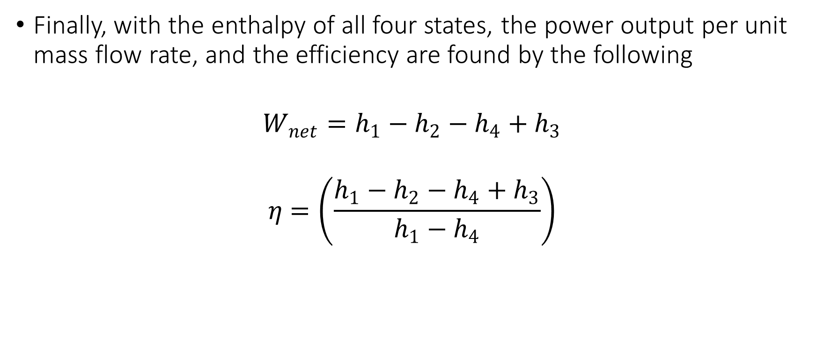
Model components
Finally, with the enthalpy of all four states, the power output per unit mass flow rate, and the efficiency are found by the following
$$W_{net}=h_{1}−h_{2}−h_{4}+h_{3}$$
$$η=\left(\frac{h_{1}−h_{2}−h_{4}+h_{3}}{h_{1}−h_{4}}\right)$$
Notes:
P4 = p1, p2 = p3

Slide 18
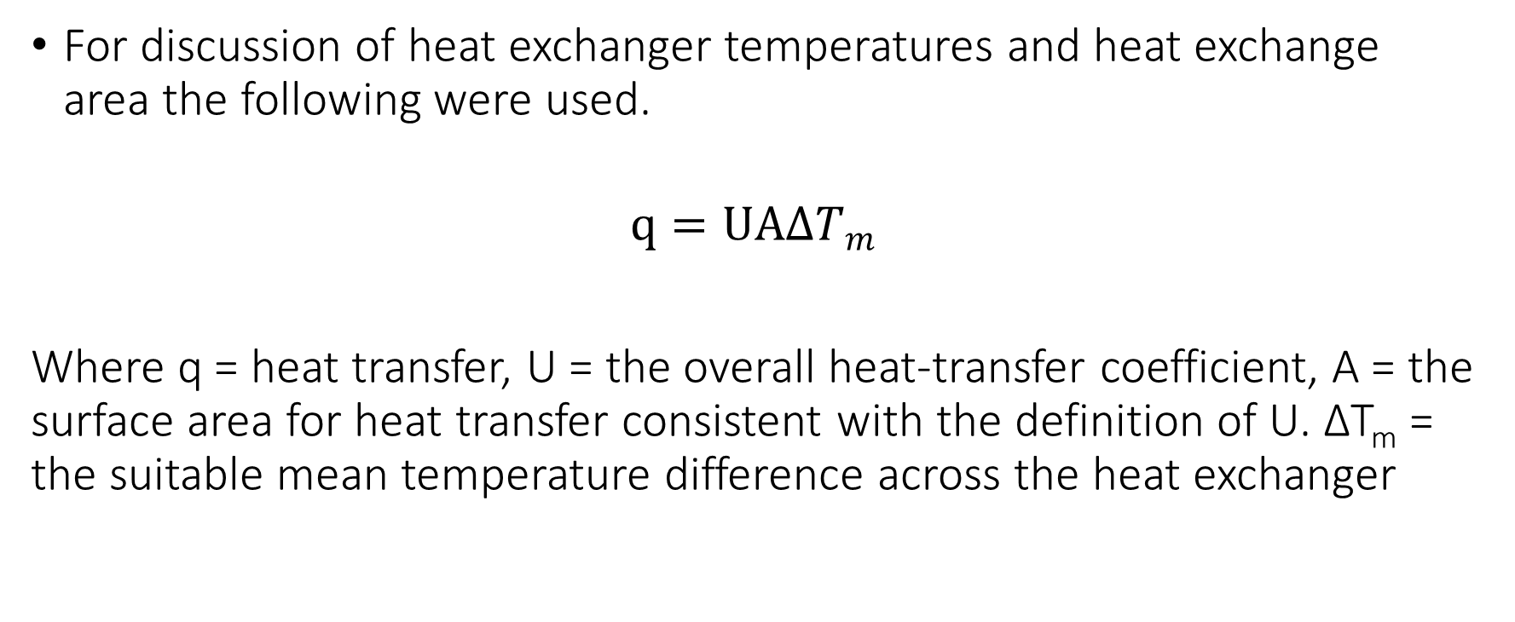
Model components
For discussion of heat exchanger temperatures and heat exchange area the following were used.
$$q=UAΔT_{m}$$
Where q = heat transfer, U = the overall heat-transfer coefficient, A = the surface area for heat transfer consistent with the definition of U. ∆T_{m} = the suitable mean temperature difference across the heat exchanger
Notes:
P4 = p1, p2 = p3

Slide 19
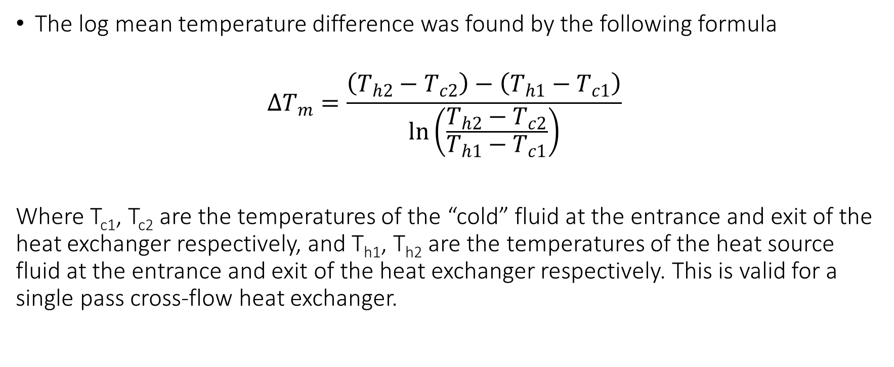
Model components
The log mean temperature difference was found by the following formula
$$ΔT_{m}=\frac{\left(T_{h2}−T_{c2}\right)−\left(T_{h1}−T_{c1}\right)}{\ln\left(\frac{T_{h2}−T_{c2}}{T_{h1}−T_{c1}}\right)}$$
Where T_{c1}, T_{c2} are the temperatures of the “cold” fluid at the entrance and exit of the heat exchanger respectively, and T_{h1}, T_{h2} are the temperatures of the heat source fluid at the entrance and exit of the heat exchanger respectively. This is valid for a single pass cross-flow heat exchanger.
Notes:
P4 = p1, p2 = p3

Slide 20
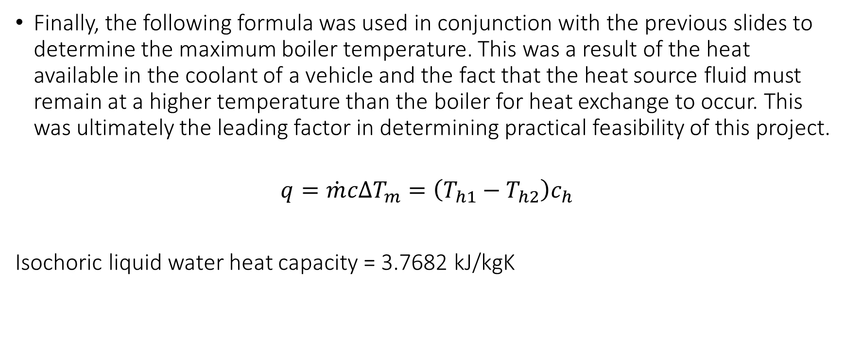
Model components
Finally, the following formula was used in conjunction with the previous slides to determine the maximum boiler temperature. This was a result of the heat available in the coolant of a vehicle and the fact that the heat source fluid must remain at a higher temperature than the boiler for heat exchange to occur. This was ultimately the leading factor in determining practical feasibility of this project.
$$q=\dot{m}cΔT_{m}=\left(T_{h1}−T_{h2}\right)c_{h}$$
Isochoric liquid water heat capacity = 3.7682 kJ/kgK

Slide 21
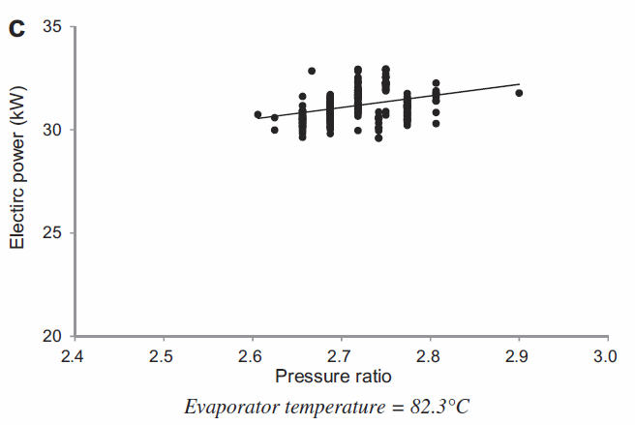
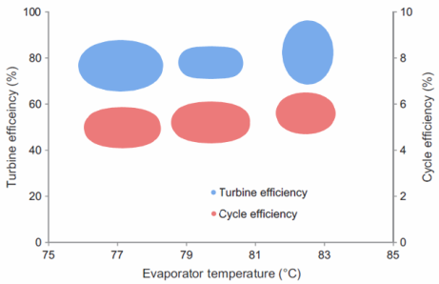
Model components
The model was then validated using a published experimental study of an organic Rankine cycle.

Slide 22
Model components
The model developed for this study predicted a power output of 44.3kW at a mass flow rate of approximately 2.5 kg/s which is about 10kW higher than what was measured.
The discrepancy is due to inefficiencies that are not considered by the model developed for this study, and specific losses unique to this system design that were not available in the published paper as well as assumptions about pump efficiency, fouling, line losses, stray heat transfer etc. that had to be made about the system to compare results.
Notes:
An error of up to 100% could easily occur if the thermal efficiency of the cycle was 5% in reality and was predicted to be 10% by the model. This is one potential weakness of the way I modelled the non-ideal pump and turbine.

Slide 23
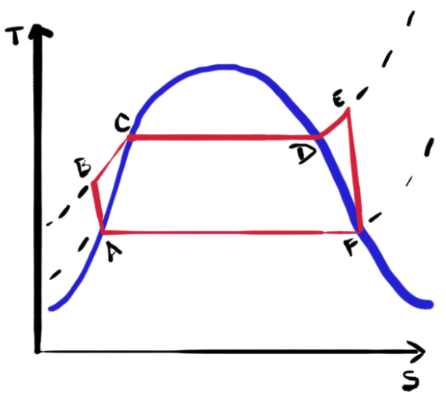
Rankine cycle
1. Isentropic expansion of the working fluid through the turbine passing the working fluid to the condenser shown as DEF in the figure below. Note that because DE departs the saturated vapor line, E represents a superheated vapor rather than a saturated vapor.
2. Isobaric heat transfer from the working fluid to the surroundings from the condenser resulting in a saturated liquid represented below by the line FA.
3. Isentropic compression in the pump to a compressed liquid passed to the boiler. Represented by the line AB.
4. Isobaric heat transfer to the working fluid from the heat source resulting in a saturated vapor ready to begin the cycle again. This is represented by the line BCD
Notes:
Isentropic expansion is really just EF. DE is the superheat which happens in the latter stage of a hypothetical boiler. One of two ways super-heat is achieved, the other is in a dry working fluid during EF.

Slide 24
Working fluid selection
Phase transition temperature
Wet vs. Dry working fluids
Heat capacity
Flammability
Notes:
c_water = 3.7682 kJ/(kgK)
C_245fa = 1.337 kJ/(kgK)

Slide 25
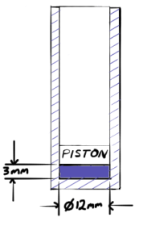
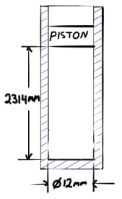
Working fluid selection
A lower phase transition temperature allows lower temperature source heat to be used. The large change in volume when a fluid transitions from a liquid to a gas is the mechanism by which power is harvested from a heat source.

Slide 26
Working fluid selection
Fluids with low phase transition temperatures are often organic molecules (hydrocarbons and refrigerants mainly) which is where the organic Rankine cycle derives its name.
Other attempts at lowering phase transition temperatures, or dynamically manipulating phase transition temperatures have been implemented. One of the more common being the Kalina cycle in which a mixture of ammonia and water is manipulated to control the phase transition temperature.
Notes:
Azeotrope: n: A liquid mixture that is characterized by a constant minimum or maximum boiling point which is lower or higher than any of the components.

Slide 27
Working fluid selection
A lot of the literature review was spent comparing the pros and cons of the ORC and the Kalina cycle, and the Kalina cycle was deemed to complex and difficult to control for the limited, and sometimes dubious efficiency gains over comparable ORC implementations.

Slide 28
Working fluid selection
“Wet” vs. “Dry” working fluids
This terminology refers to what happens to a working fluid when the entropy is held relatively constant as the temperature of the working fluid is reduced.
If a saturated vapor condenses, it is referred to as a wet working fluid, if it becomes super-heated, it is referred to as a dry working fluid. If it remains a saturated vapor, it is referred to as an isentropic working fluid.

Slide 29
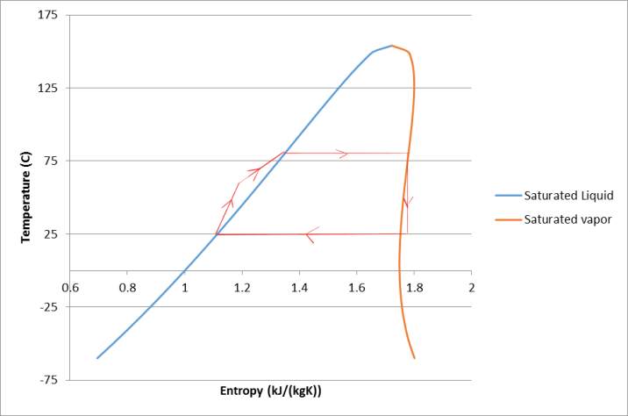
Working fluid selection
Because dry working fluids do not condense, there is less risk of damage to turbine blades due to high velocity contact with condensate.
Isentropic fluids are better still because no energy is used to heat the fluid beyond its saturated temperature, and a more efficient cycle is possible. The T-s diagram to the right is for the selected working fluid R245fa, and isentropic fluid.

Slide 30
Working fluid selection
Heat capacity
Large heat capacity is a desirable trait of a working fluid because comparatively more heat can be transferred to the fluid with an equal rise in temperature. This results in smaller heat exchangers and slower mass flow rates for similar cycles.
R245fa and other refrigerants have relatively high heat capacities for organic fluids, though not nearly as high as water.
Notes:
c_water = 3.7682 kJ/(kgK)
C_245fa = 1.337 kJ/(kgK)

Slide 31
Working fluid selection
Flammability
Finally, many of the organic working fluids were ruled out as potential candidates due to the fact that they were flammable.
Notes:
Propane, isobutane etc.

Slide 32
Working pressure development
Given a working pressure, and a state of either saturated vapor or saturated liquid, many other properties of a working fluid can be determined
Temperature
Enthalpy
Entropy
Specific volume

Slide 33
Working pressure development
Because heat will always transfer from a high heat source to a low heat sink to reach an equilibrium, it is not possible to transfer heat to a cycle if the waste heat temperature is not greater than the working temperature of the boiler.
Similarly, heat can not be rejected from a cycle if the temperature of the working fluid in the condenser is not higher than the heat sink temperature, often the ambient air.

Slide 34
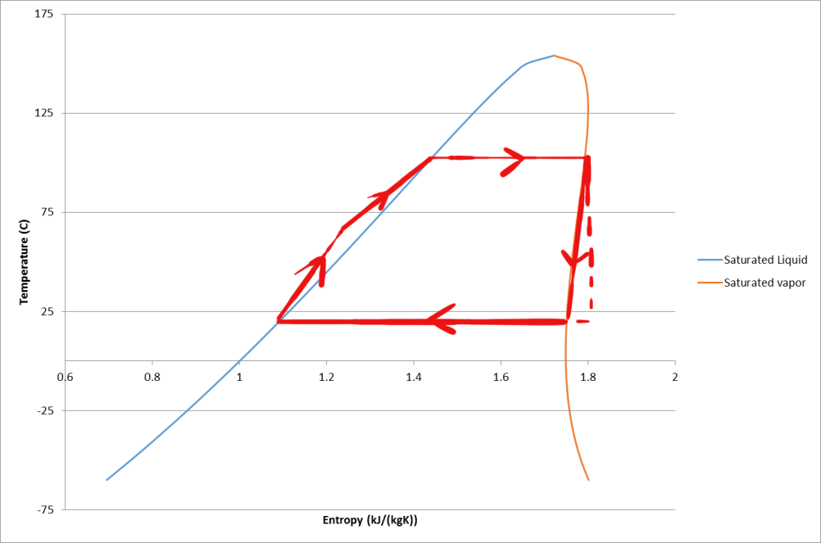
Working pressure development
Considering a maximum working temperature of the boiler equal to the temperature of an automotive cooling loop ~100ºC, the T-s diagram was amended to the following.

Slide 35
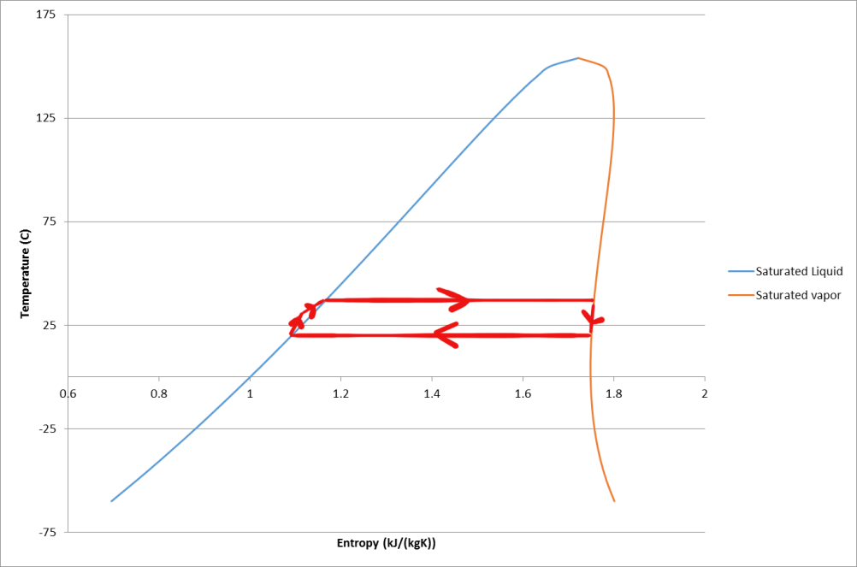
Working pressure development
This diagram shows the reduced boiler temperature to reflect the lack of heat available from the heat source – the vehicle cooling loop.

Slide 36
Working pressure development
This diagram assumes a working temperature of less than 25ºC which severely limits the operating environments in which this system is viable. Under-hood temperatures frequently exceed 40ºC.

Slide 37
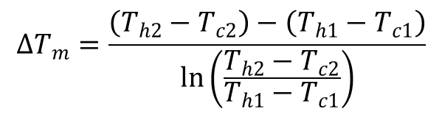
Heat exchangers
A log mean temperature difference model for a single pass, cross-flow heat exchanger was used to estimate heat exchanger area requirements for a system like this.
$$ΔT_{m}=\frac{\left(T_{h2}−T_{c2}\right)−\left(T_{h1}−T_{c1}\right)}{\ln\left(\frac{T_{h2}−T_{c2}}{T_{h1}−T_{c1}}\right)}$$

Slide 38

Heat exchangers
This temperature difference can then be used to determine the heat exchange area using this heat exchanger heat transfer equation.
$$q=UAΔT_{m}$$

Slide 39
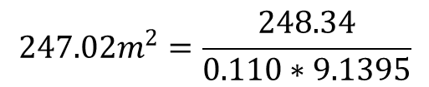
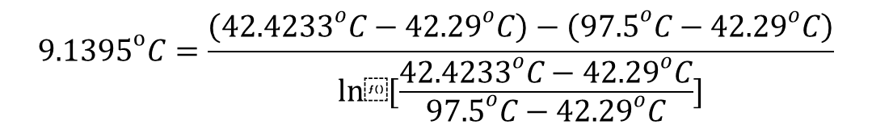
Heat exchangers
Using these equations, the following estimates were acquired
$${9.1395}^{o}C=\frac{\left({42.4233}^{o}C−{42.29}^{o}C\right)−\left({97.5}^{o}C−{42.29}^{o}C\right)}{ln⁡[\frac{{42.4233}^{o}C−{42.29}^{o}C}{{97.5}^{o}C−{42.29}^{o}C}]}$$
$$247.02m^{2}=\frac{248.34}{0.110∗9.1395}$$

Slide 40
Heat exchangers
Tube length | Number of tubes | Tube diameter
1 | 6191 | 12.7
2 | 3095
3 | 2064
4 | 1548
5 | 1238

Slide 41
Conclusion
It was apparent at this stage of the project that the heat available was too little, and that heat exchanger size requirements were prohibitively large. A viable organic Rankine cycle is possible with similar temperature waste heat, but not in an automotive application.
Notes:
Pull up the GHSP study PGR presentation for more discussion points and future research capability.

